Slide 1


Data Enthusiast
Home
About
ghazaputra99@gmail.com
Sales Force Training
FPROJECT DATA SCIENCE
Muhammad Ghaza Eka Putra
DataFrame, Descriptive Statistics (Central Tendency & Variability), T-Test

Slide 2



Data Enthusiast
Overview
About
ghazaputra99@gmail.com
Overview - Background Problem Project
Company X aims to improve its sales performance.
Previous sales data shows an average of $100 per transaction. The company plans to conduct a training program for its sales team, using a sample of 25 employees.
This project is conducted to analyze whether the training has a significant impact on sales performance, based on a sample of 25 sales employees.
The project begins by creating a TransactionAmount DataFrame, followed by an analysis of measures of central tendency and variability. A T-Test is then performed to evaluate the effectiveness of the sales training.
Learn More
https://github.com/ghaza-putra

Slide 3
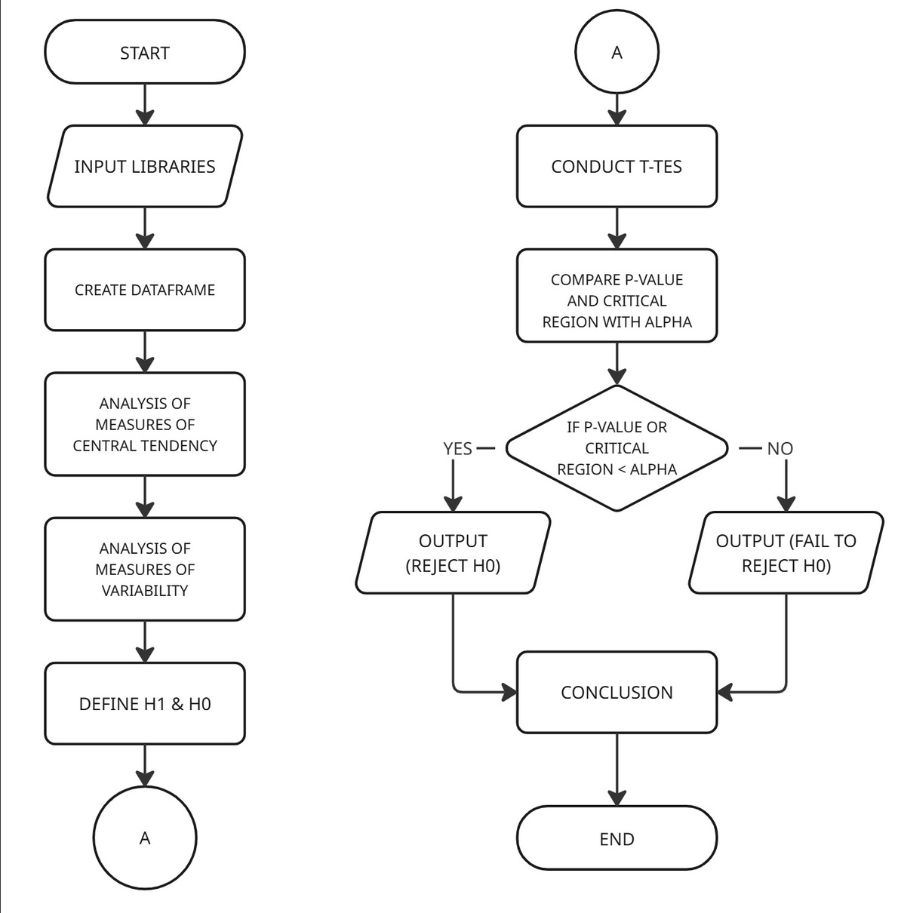
Data Enthusiast
Steps
About
ghazaputra99@gmail.com
Flowchart
Create a DataFrame with 25 transaction data entries in the TransactionAmount column.
Perform an analysis of measures of central tendency (mean, median, mode).
Conduct an analysis of measures of variability, including variance, standard deviation, maximum and minimum values, range, and quartiles.
Define H₀ and H₁ as preparation for conducting a T-Test.
Perform a sample T-Test with a 5% alpha level.
Draw a conclusion based on the results of the sales force training evaluation.
https://github.com/ghaza-putra

Slide 4

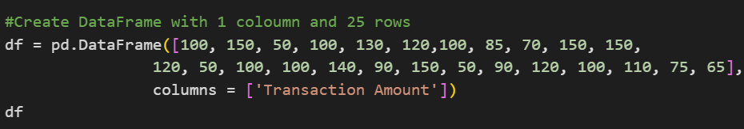


Data Enthusiast
Methodology
About
ghazaputra99@gmail.com
1) Create Dataframe
To consolidate all data into one place, a DataFrame must be created first before any further analysis can be performed.
The syntax used is:
The dataset contains 25 entries with a single column named “TransactionAmount.”
Learn More
https://github.com/ghaza-putra

Slide 5
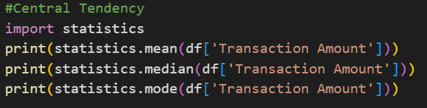

Data Enthusiast
Methodology
About
ghazaputra99@gmail.com
2) Central Tendency Analysis
In performing the analysis of measures of central tendency, it is necessary to calculate the Mean, Median, and Mode.
The syntax used is:
Based on the calculation, the results are as follows:
Mean: 102.6
Median: 100
Mode: 100
This indicates that the data is generally centered around 100.
Learn More
https://github.com/ghaza-putra

Slide 6
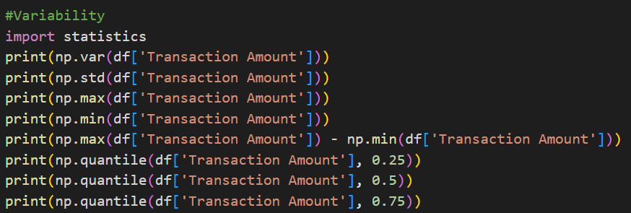
Data Enthusiast
Methodology
About
ghazaputra99@gmail.com
3) Variability Analysis
In performing the analysis of measures of variability, it is necessary to calculate the Variance, Standard Deviation, Maximum, Minimum, Range (difference between Max and Min), Quartile 1 (Q1), Quartile 2 (Q2), and Quartile 3 (Q3).
The syntax used is:
Based on the calculation, the results are as follows:
Variance: 972.24
Standard Deviation: 31.18
Maximum Value: 150
Minimum Value: 50
Range: 100
Quartile 1 (Q1): 85
Quartile 2 (Q2 / Median): 100
Quartile 3 (Q3): 120
The data indicates a substantial level of dispersion, as reflected by a range of 100 and a standard deviation of 31.18. These values suggest that the transaction amounts vary significantly around the mean, indicating high variability within the dataset.
Learn More
https://github.com/ghaza-putra

Slide 7

Data Enthusiast
Methodology
About
ghazaputra99@gmail.com
4) T-Test Process
Hypothesis Statements:
H₀ (Null Hypothesis):
The average transaction amount from the 25 salespersons after training is μ = 100.
H₁ (Alternative Hypothesis):
The average transaction amount from the 25 salespersons after training is μ > 100.
Significance Level:
Define α = 0.05 (5%)
Result :
T-statistic = 0.40850016
P-value= 0.68652848
Critical Region = 1.6991270265334972
Analysis:
Since the p-value (0.69) > alpha (0.05), we fail to reject H₀.
Since the test statistic (0.41) < critical value (1.69), we fail to reject H₀.
Therefore, there is insufficient evidence to conclude that the average transaction amount from the 25 salespeople after training is greater than 100.
Learn More
https://github.com/ghaza-putra

Slide 8



Data Enthusiast
Conclusion
About
ghazaputra99@gmail.com
Project Conclusion:
Result:
Based on the results of the two statistical tests conducted, the decision is to fail to reject the null hypothesis (H₀). Therefore, there is insufficient evidence to suggest that the average transaction amount after the training is greater than 100. This means that the training provided has not been statistically proven to increase the average transaction amount of the salespersons.
Project Objective:
This project aims to analyze whether the training provided to 25 salespersons has an effect on increasing the average transaction amount.
Learn More
https://github.com/ghaza-putra

Slide 9


Data Enthusiast
Home
About
Contact
Thank You
FOR YOUR ATTENTION
ghazaputra99@gmail.com
https://www.linkedin.com/in/muhammadghazaekaputra
https://github.com/ghaza-putra
Presented By
Muhammad Ghaza Eka Putra

